Slide 1
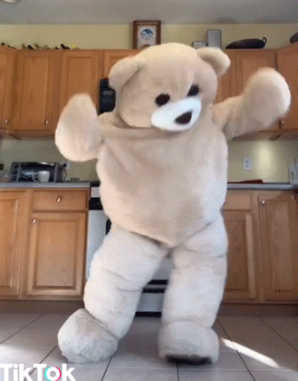
Team
Pacman
- Iteration 3 -

Slide 2
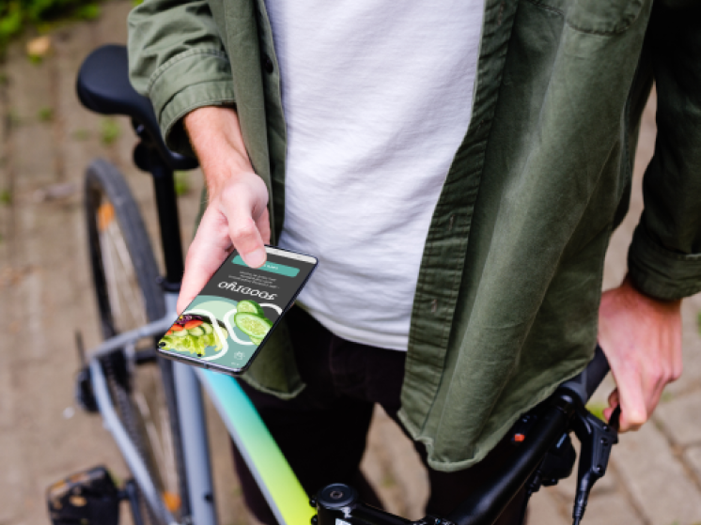
What is it all about?
Use cases & usability goals
HiFi Prototype
Heuristic Evaluation
Discussion
AGENDA
Notes:
Our HMW question

Slide 3
How might we support young people in finding recipe inspirations with ingredients they already have at home
to prepare great dishes?
Notes:
Our HMW question

Slide 4
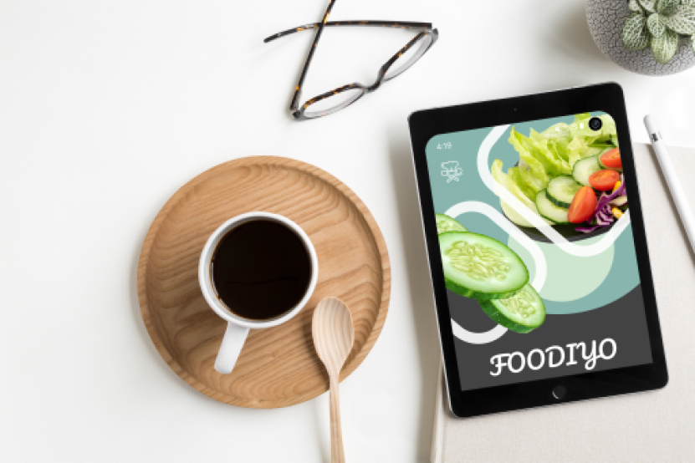
FOODIYO
- discover new recipes -
The goal of the app is for people to discover new recipes with the ingredients they have already at home.
App designed for everybody, but more focused on the youth.
Possibility to scan your own fridge, select different food/diet types or the duration of meal.

Slide 5
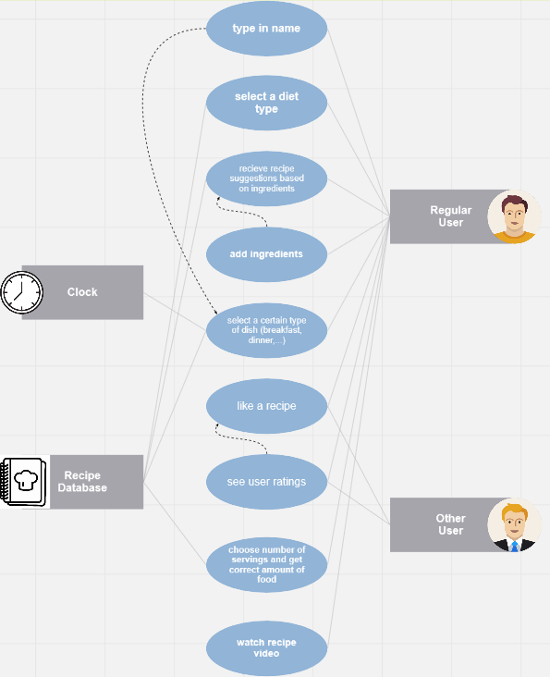
UML USE CASES

Slide 6
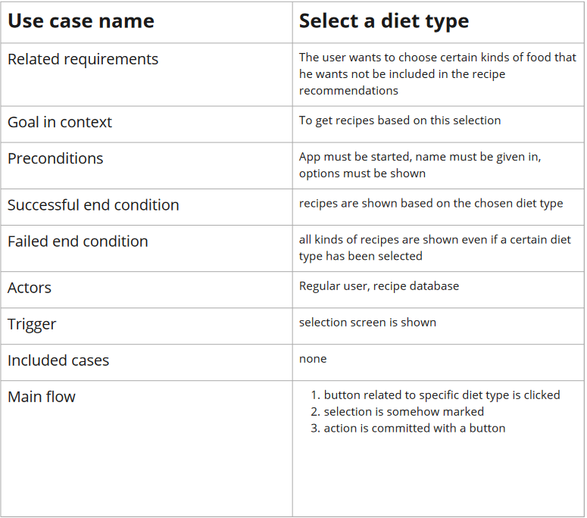
a use case in detail ...
Notes:
An Empathy Map is just one tool that can help you empathise and synthesise your observations from the research phase, and draw out unexpected insights about your user’s needs.
An Empathy Map allows us to sum up our learning from engagements with people in the field of design research. The map provides four major areas in which to focus our attention on, thus providing an overview of a person’s experience. Empathy maps are also great as a background for the construction of the personas that you would often want to create later.

Slide 7
Important Design Principles
Flexibility & efficiency of use
Match between system and real world
Consistency and standards
Visibility of the system status
Aesthetic and minimalistic design
Notes:
An Empathy Map is just one tool that can help you empathise and synthesise your observations from the research phase, and draw out unexpected insights about your user’s needs.
An Empathy Map allows us to sum up our learning from engagements with people in the field of design research. The map provides four major areas in which to focus our attention on, thus providing an overview of a person’s experience. Empathy maps are also great as a background for the construction of the personas that you would often want to create later.

Slide 8
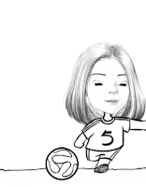
Our usability goals
intuitive, consistent and illustrative design
provide the ability to personalize the information
simple and natural communication
provide help and relevant information
https://c.tenor.com/f6cqdmWULgUAAAAj/jagyasini-jagyasini-singh.gif

Slide 9
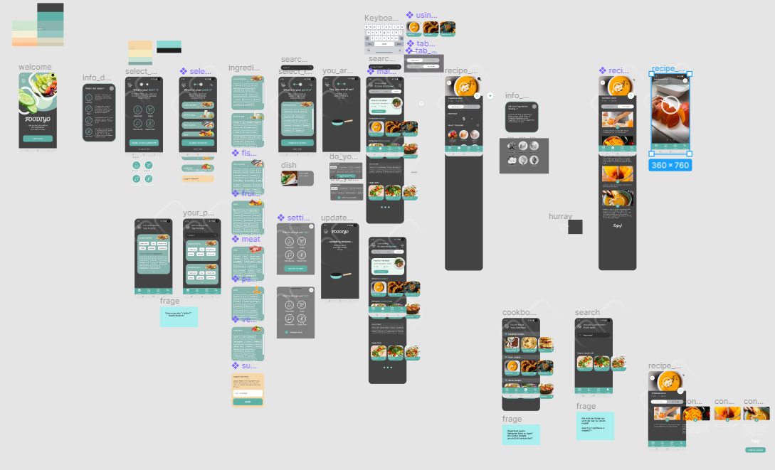
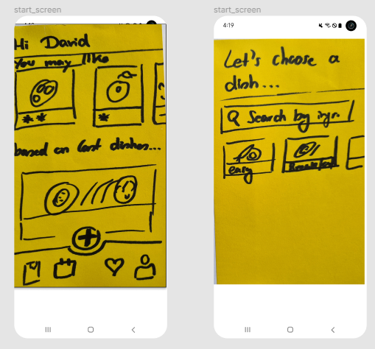
work in progress...

Slide 10
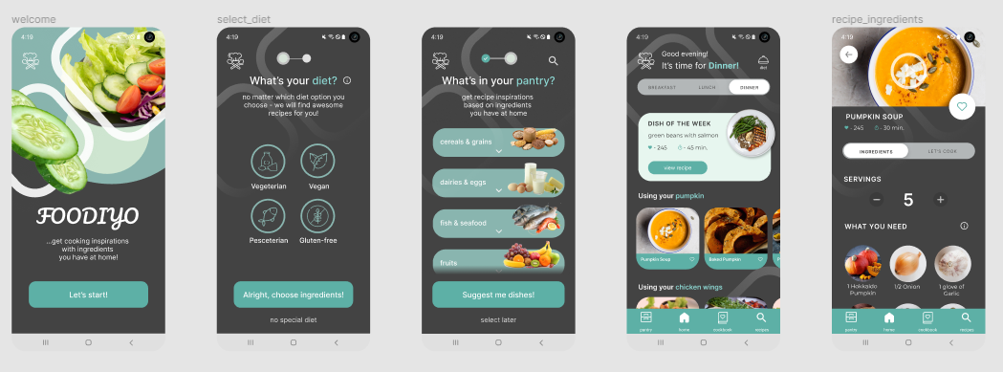
HiFi Prototype

Slide 11
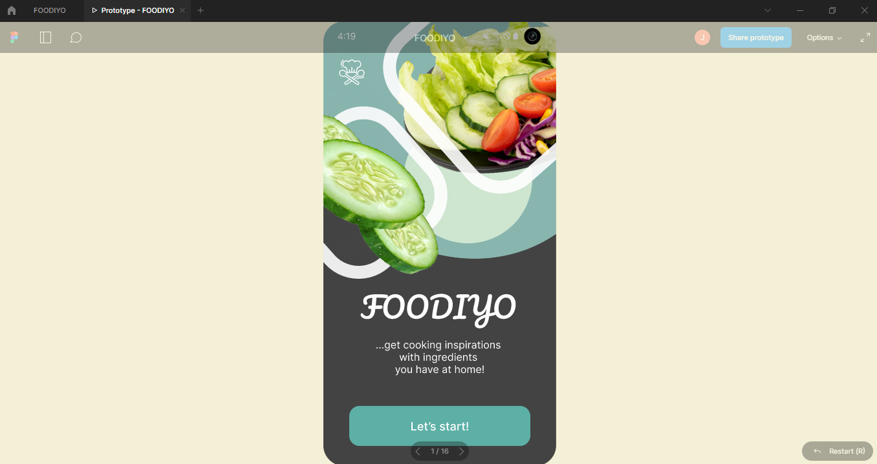
Notes:
Here: live presenation of prototype?

Slide 12
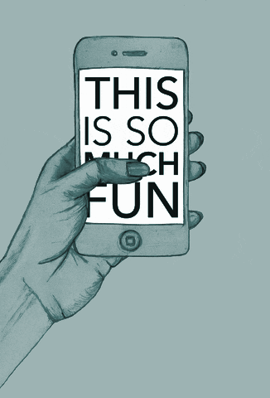
Heuristic Evaluation
“very efficient to use”
“The main screen in total is a little bit too crowded”
“The visibility of the system status is well implemented e.g. by means of coloring”
“Adding photos to illustrate the cooking process would be useful”
“The pantry icon may lead to confusions”
“To adjust the ingredients in the pantry and receive new recipes a confirm button is missing”
“To improve consistency also the transitions between the slides should work in the same way”
“good, consistent and clear design”
https://giphy.com/gifs/transparent-63I6FXZTXks2A
Notes:
https://giphy.com/gifs/klarna-reaction-reactions-tap-xvqIOHfQvth5NeoT0Y
https://giphy.com/gifs/transparent-63I6FXZTXks2A

Slide 13

What to improve...
→ add photos to illustrate the cooking process
→ add descriptions for the app bar
→ improve the functionality of the “X” button
→ remove irrelevant information on the main screen
→ add a title on the video screen to help the user recognize the recipe he is cooking
→ add an option to update recipes or get alternative ingredients if one ingredient is missing
→ add general help-buttons
https://c.tenor.com/f6cqdmWULgUAAAAj/jagyasini-jagyasini-singh.gif

Slide 14
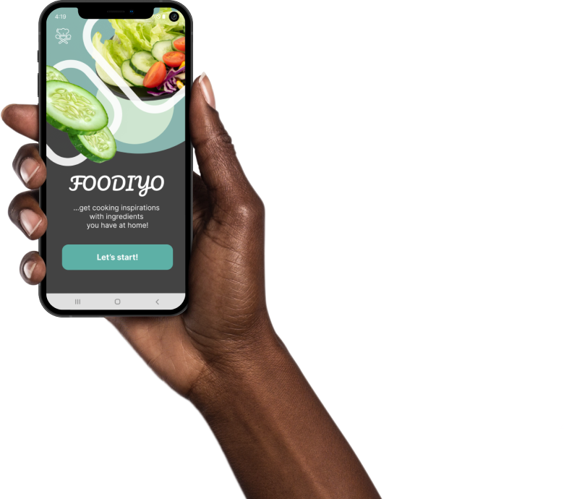
Thanks for your attention!
Questions to be answered…
two search buttons in “pantry” → alternative?

